Slide 1


Performance
Improvements
in .NET 9
Stephen Toub

Slide 2
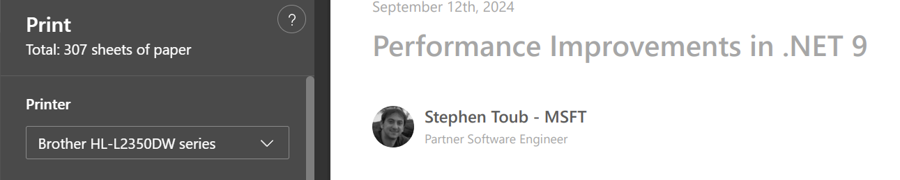
https://devblogs.microsoft.com/dotnet/performance-improvements-in-net-9/
But… can’t cover 350+ PRs in 45 minutes, so instead…

Slide 3


Slide 4

GetAlternateLookup

Slide 5

MemoryExtensions.Split
Regex.EnumerateSplits

Slide 6

SearchValues<string>

Slide 7

TensorPrimitives.<T>

Slide 8

Thank you!
https://aka.ms/net9perf

